Slide 1
JavaScript & jQuery

Slide 2

Submit Homework
Submit your GitHub URLs

Slide 3
Last Week Review
CDNs
What are they
How to use them
Google Fonts
Twitter Bootstrap
Git and GitHub
History of
Workflow
GitHub Pages
Deployment

Slide 4
This week overview
Gabriel Flores Presentation
How the Internet Works
JavaScript
History of
Importance
Use Cases

Slide 5
Homework Change
Next week we will cover
HTML 5 Video
YouTube Embedding
JavaScript Filtering
This Week
JavaScript Lightbox

Slide 6
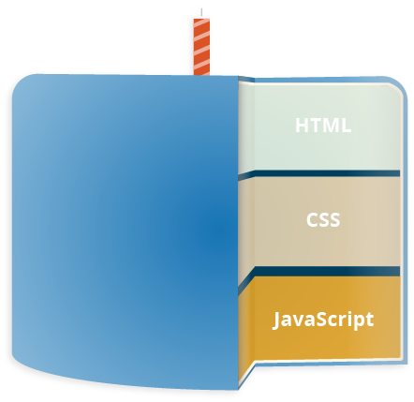
What is JavaScript
“JavaScript is a scripting or programming language that allows you to implement complex things on web pages” - MDN web docs
JavaScript is what makes your website functional and no longer static

Slide 7
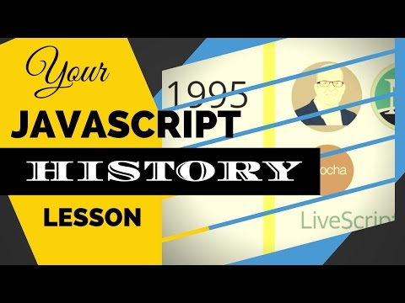

Slide 8
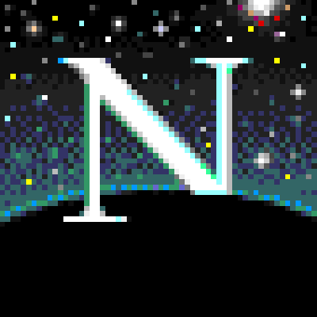
JavaScript: A Brief History
In 1995 Netscape Communications recruited Brendan Eich “The Father of JavaScript”
Netscape Communications was about to partner with Sun Microsystems to include Java into Netscape Navigator to compete with Microsoft
Java was not the language Netscape envisioned for its developers
Netscape wanted a faster, easier language for scripters, amateurs, and designers to pick up
Java for big enterprise applications
JavaScript for small scripting tasks

Slide 9
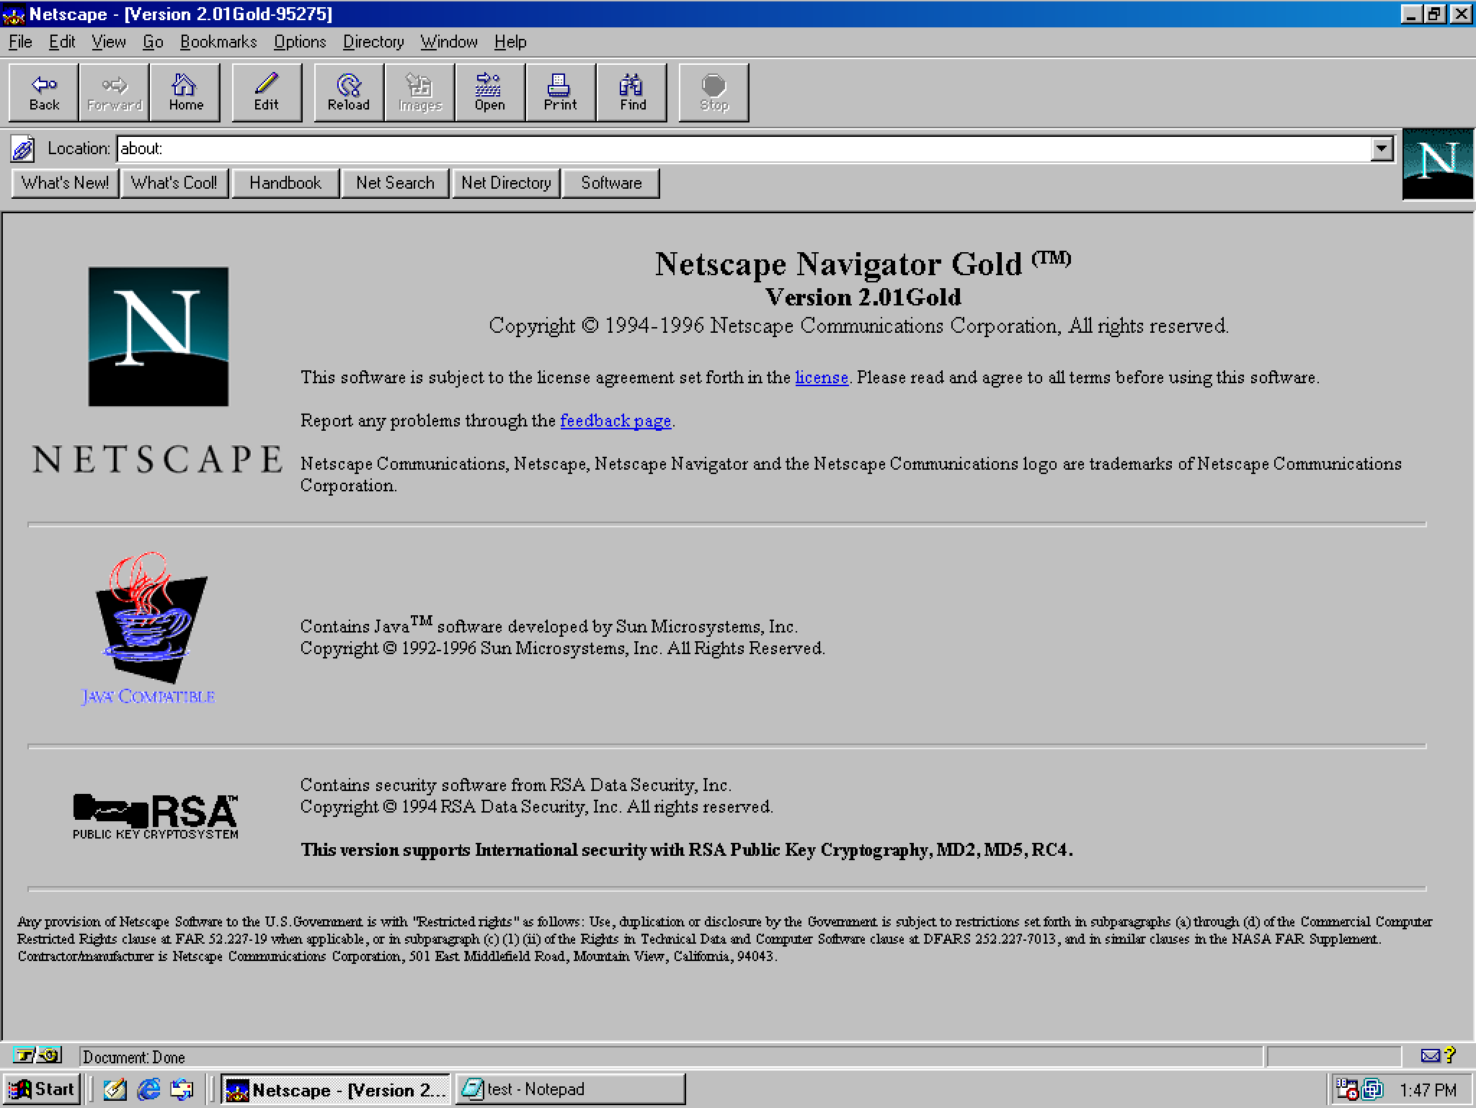
JavaScript: A Brief History contd.
Brendan was able to choose the tools and knew the individuals calling the shots at Netscape to choose what this companion language would be
The only thing he didn’t have was time
In May of 1995 with only 10 days Eich wrote the first JavaScript prototype JavaScript
JavaScript was integrated into Netscape Navigator 2.0 in 1995

Slide 10
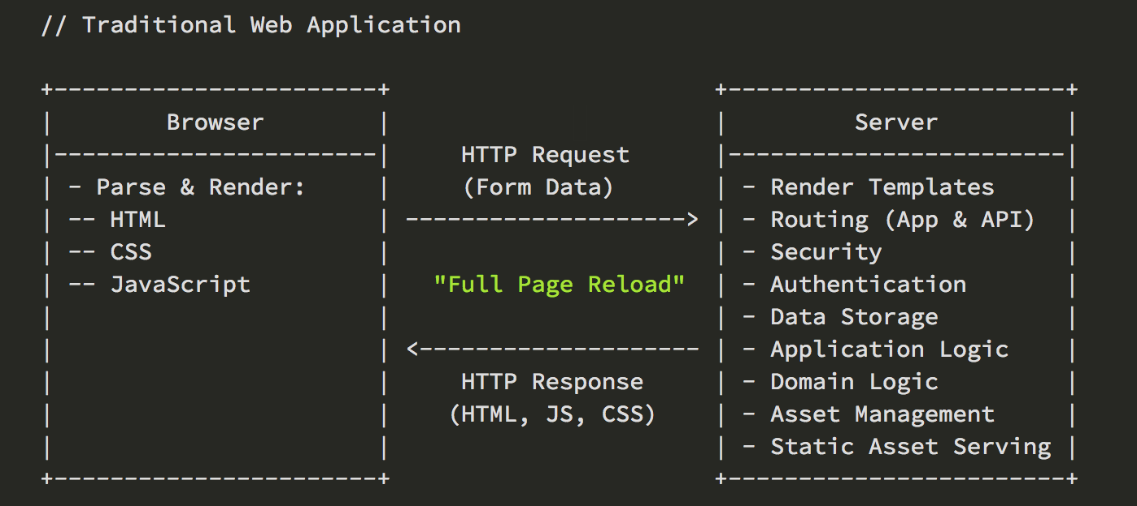
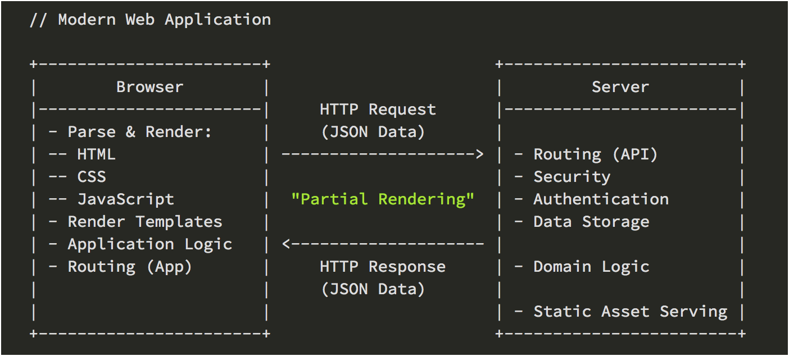
Why is JavaScript important?
JavaScript helps us rewrite Web Applications

Slide 11
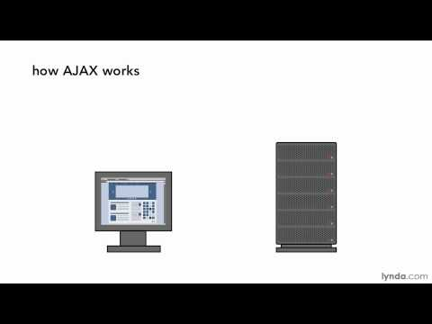
AJAX

Slide 12
Why is JavaScript Important?
Do things HTML & CSS are unable to provide
Write Full stack applications
Client-Side Scripts
Server-Side Code
Enhances the user experience
Create interactivity
Comes in all shapes and sizes
Frameworks
Libraries
Transpilers
JavaScript is:
Analytics
Education
Games
Creativity
Flexibility

Slide 13
What is jQuery?
jQuery is a JavaScript library
jQuery greatly simplifies JavaScript programming
jQuery is easy to learn
https://www.w3schools.com/whatis/whatis_jquery.asp

Slide 14
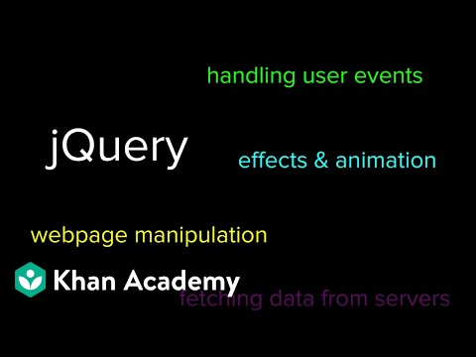
JavaScript: jQuery
LINK

Slide 15
jQuery Lightbox

Slide 16
Open up your class-directory
Make a new HTML file called “jquery-lightbox.html”
Copy the HTML boilerplate code from “template.html”
Paste boilerplate code in your jquery-lightbox.html
Update your <title>
Go to “code.jquery.com”
Select jQuery 3.x
minified
Copy the <script> code
Paste before closing <body> in your jquery-lightbox.html
Go to https://lokeshdhakar.com/projects/lightbox2/
Click the download button
Unzip contents of the “lightbox2-master” folder
Copy the following
lightbox2-master/dist/css/lightbox.min.css >>> to your stylesheets folder
lightbox2-master/dist/images/[all of them] >>> to your images folder
lightbox2-master/dist/js/lightbox.min.js >>> to your javascripts folder
Link up the Lightbox CSS and JS

Slide 17
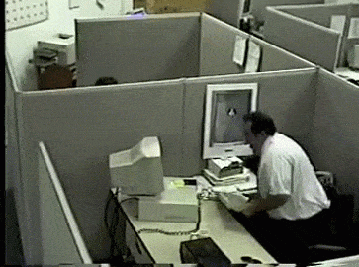
Ok take a minute we got more

Slide 18
jQuery Lightbox contd
Go to my github
Scroll or search and find “Image Share Link”
Click and download all the images
Make a new folder in your images directory called “lightbox”
Unzip the images you downloaded and move them into your “lightbox” directory you just created
At this point you should have large images and related thumbnails
Link up and display the first image “kitten-1-thumbnail.jpg”
Now that you have the thumbnail image displayed wrap an <a> tag around your image
Follow the example code found in “Initialize HTML” in the Lightbox documentation
We will continue building and fixing as we go

Slide 19

You should now have a working Lightbox

Slide 20
What more of a challenge
Add a grid system of some kind around your images
Apply some of the lightbox JavaScript Options
Move the Lightbox images you downloaded that were part of the plugin and move them into /assets/images/lightbox/icons and relink them in the lightbox.min.css

Slide 21

Homework
Read
Ch 19
Code
Home (HTML Video next week)
Discography

